Slide 1







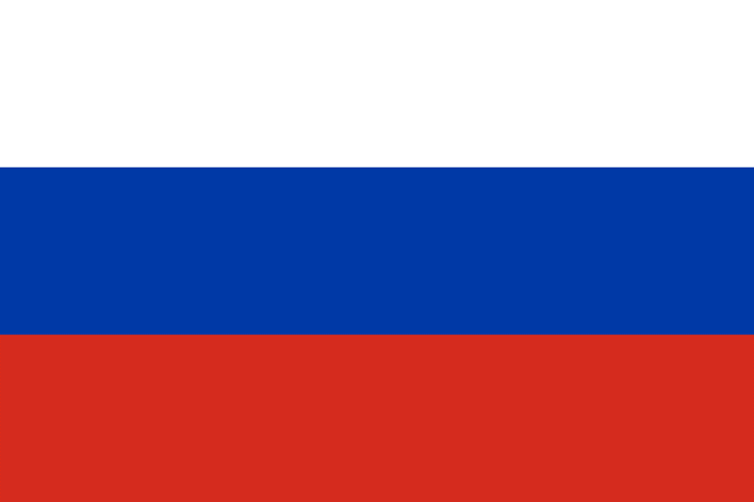


10
9
8
7
6
5
4
3
2
1
Albania
Thailand
Japan
The Netherlands
South Korea
Bolivia
South Africa
Russia
Australia
Canada
The quick brown fox jumps
over the lazy dog.
The quick brown fox jumps
over the lazy dog.
The quick brown fox jumps
over the lazy dog.
The quick brown fox jumps
over the lazy dog.
The quick brown fox jumps
over the lazy dog.
The quick brown fox jumps
over the lazy dog.
The quick brown fox jumps
over the lazy dog.
The quick brown fox jumps
over the lazy dog.
The quick brown fox jumps
over the lazy dog.
The quick brown fox jumps
over the lazy dog.
The quick brown fox jumps
over the lazy dog.
The quick brown fox jumps
over the lazy dog.
The quick brown fox jumps
over the lazy dog.
The quick brown fox jumps
over the lazy dog.
The quick brown fox jumps
over the lazy dog.
The quick brown fox jumps
over the lazy dog.
The quick brown fox jumps
over the lazy dog.
The quick brown fox jumps
over the lazy dog.
The quick brown fox jumps
over the lazy dog.
The quick brown fox jumps
over the lazy dog.
The quick brown fox jumps
over the lazy dog.
The quick brown fox jumps
over the lazy dog.
The quick brown fox jumps
over the lazy dog.
The quick brown fox jumps
over the lazy dog.
The quick brown fox jumps
over the lazy dog.
The quick brown fox jumps
over the lazy dog.
The quick brown fox jumps
over the lazy dog.
The quick brown fox jumps
over the lazy dog.
The quick brown fox jumps
over the lazy dog.
The quick brown fox jumps
over the lazy dog.

Slide 2

10
9
8
7
6
5
4
3
2
1
India
Thailand
Japan
The Netherlands
South Korea
Bolivia
South Africa
Russia
Australia
Canada
The quick brown fox jumps
over the lazy dog.
The quick brown fox jumps
over the lazy dog.
The quick brown fox jumps
over the lazy dog.
The quick brown fox jumps
over the lazy dog.
The quick brown fox jumps
over the lazy dog.
The quick brown fox jumps
over the lazy dog.
The quick brown fox jumps
over the lazy dog.
The quick brown fox jumps
over the lazy dog.
The quick brown fox jumps
over the lazy dog.
The quick brown fox jumps
over the lazy dog.
The quick brown fox jumps
over the lazy dog.
The quick brown fox jumps
over the lazy dog.
The quick brown fox jumps
over the lazy dog.
The quick brown fox jumps
over the lazy dog.
The quick brown fox jumps
over the lazy dog.
The quick brown fox jumps
over the lazy dog.
The quick brown fox jumps
over the lazy dog.
The quick brown fox jumps
over the lazy dog.
The quick brown fox jumps
over the lazy dog.
The quick brown fox jumps
over the lazy dog.
The quick brown fox jumps
over the lazy dog.
The quick brown fox jumps
over the lazy dog.
The quick brown fox jumps
over the lazy dog.
The quick brown fox jumps
over the lazy dog.
The quick brown fox jumps
over the lazy dog.
The quick brown fox jumps
over the lazy dog.
The quick brown fox jumps
over the lazy dog.
The quick brown fox jumps
over the lazy dog.
The quick brown fox jumps
over the lazy dog.
The quick brown fox jumps
over the lazy dog.

Slide 4






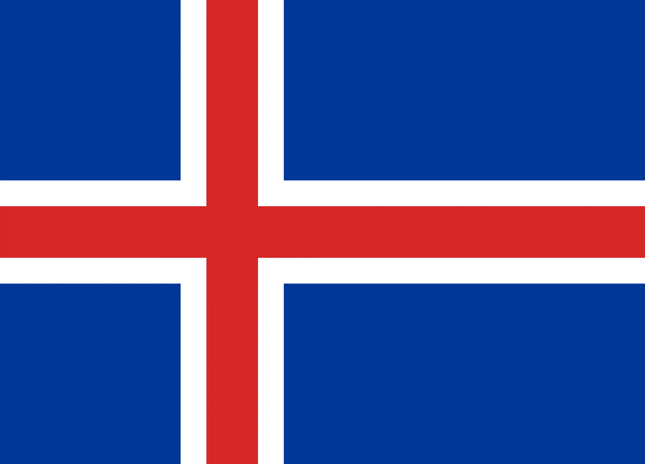
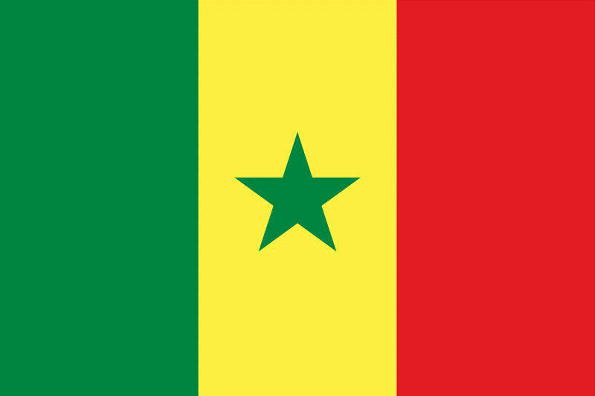


20
19
18
17
16
15
14
13
12
11
10
9
8
7
6
5
4
3
2
1
Egypt
Kazakhstan
China
Greece
Suriname
France
United States
Greenland
Iceland
Senegal
Albania
Thailand
Japan
The Netherlands
South Korea
Bolivia
South Africa
Russia
Australia
Canada
The quick brown fox jumps
over the lazy dog.
The quick brown fox jumps
over the lazy dog.
The quick brown fox jumps
over the lazy dog.
The quick brown fox jumps
over the lazy dog.
The quick brown fox jumps
over the lazy dog.
The quick brown fox jumps
over the lazy dog.
The quick brown fox jumps
over the lazy dog.
The quick brown fox jumps
over the lazy dog.
The quick brown fox jumps
over the lazy dog.
The quick brown fox jumps
over the lazy dog.
The quick brown fox jumps
over the lazy dog.
The quick brown fox jumps
over the lazy dog.
The quick brown fox jumps
over the lazy dog.
The quick brown fox jumps
over the lazy dog.
The quick brown fox jumps
over the lazy dog.
The quick brown fox jumps
over the lazy dog.
The quick brown fox jumps
over the lazy dog.
The quick brown fox jumps
over the lazy dog.
The quick brown fox jumps
over the lazy dog.
The quick brown fox jumps
over the lazy dog.
The quick brown fox jumps
over the lazy dog.
The quick brown fox jumps
over the lazy dog.
The quick brown fox jumps
over the lazy dog.
The quick brown fox jumps
over the lazy dog.
The quick brown fox jumps
over the lazy dog.
The quick brown fox jumps
over the lazy dog.
The quick brown fox jumps
over the lazy dog.
The quick brown fox jumps
over the lazy dog.
The quick brown fox jumps
over the lazy dog.
The quick brown fox jumps
over the lazy dog.
The quick brown fox jumps
over the lazy dog.
The quick brown fox jumps
over the lazy dog.
The quick brown fox jumps
over the lazy dog.
The quick brown fox jumps
over the lazy dog.
The quick brown fox jumps
over the lazy dog.
The quick brown fox jumps
over the lazy dog.
The quick brown fox jumps
over the lazy dog.
The quick brown fox jumps
over the lazy dog.
The quick brown fox jumps
over the lazy dog.
The quick brown fox jumps
over the lazy dog.
The quick brown fox jumps
over the lazy dog.
The quick brown fox jumps
over the lazy dog.
The quick brown fox jumps
over the lazy dog.
The quick brown fox jumps
over the lazy dog.
The quick brown fox jumps
over the lazy dog.
The quick brown fox jumps
over the lazy dog.
The quick brown fox jumps
over the lazy dog.
The quick brown fox jumps
over the lazy dog.
The quick brown fox jumps
over the lazy dog.
The quick brown fox jumps
over the lazy dog.
The quick brown fox jumps
over the lazy dog.
The quick brown fox jumps
over the lazy dog.
The quick brown fox jumps
over the lazy dog.
The quick brown fox jumps
over the lazy dog.
The quick brown fox jumps
over the lazy dog.
The quick brown fox jumps
over the lazy dog.
The quick brown fox jumps
over the lazy dog.
The quick brown fox jumps
over the lazy dog.
The quick brown fox jumps
over the lazy dog.
The quick brown fox jumps
over the lazy dog.

Slide 5









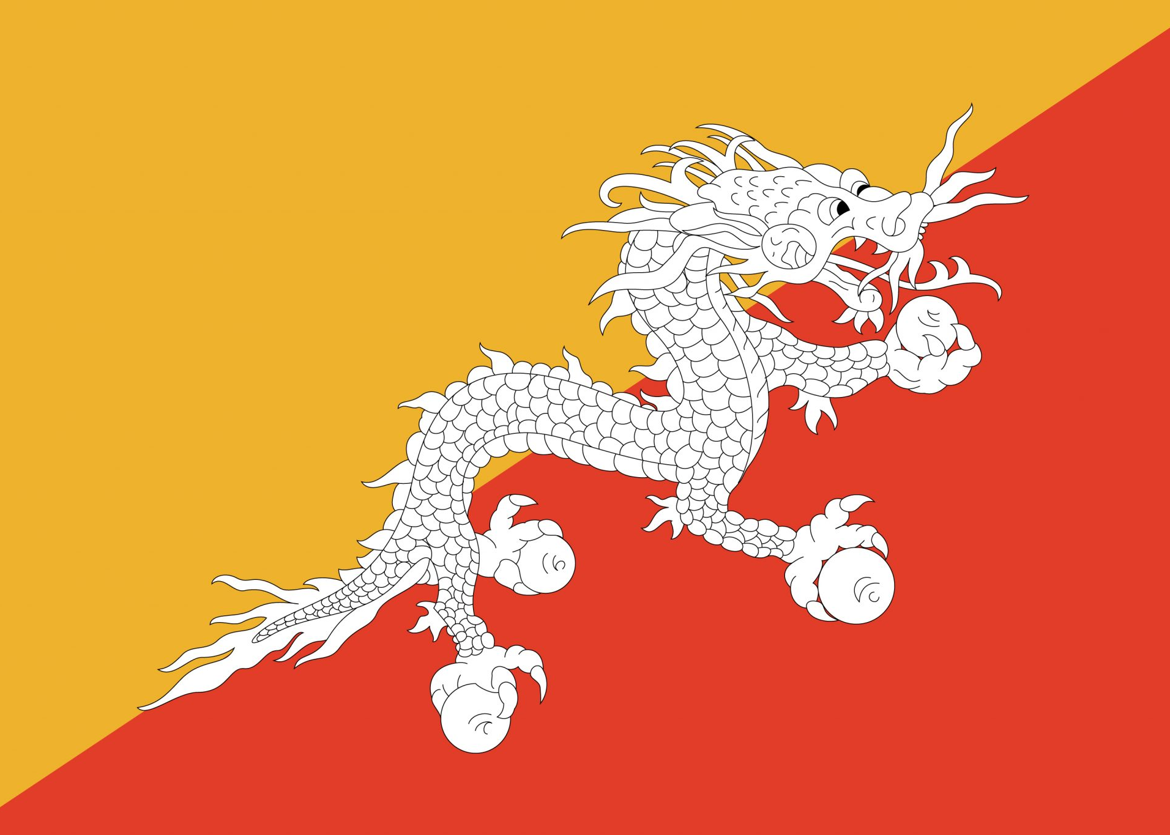








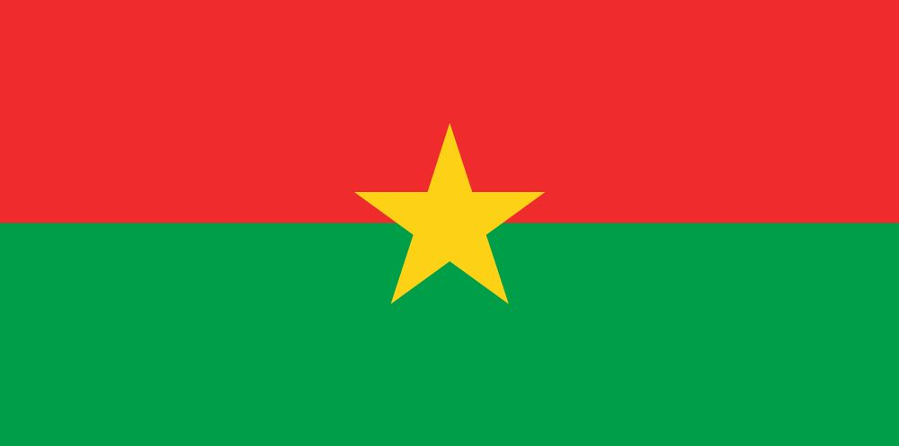












50
49
48
47
46
45
44
43
42
41
40
39
38
37
36
35
34
33
32
31
30
29
28
27
26
25
24
23
22
21
20
19
18
17
16
15
14
13
12
11
10
9
8
7
6
5
4
3
2
1
The
Philippines
Vietnam
England
Morocco
Côte d'Ivoire
Sri Lanka
Chad
Singapore
Denmark
Croatia
Bhutan
Barbados
San Marino
Somalia
Portugal
Burundi
Serbia
Turkey
Venezuela
Burkina Faso
Lebanon
Scotland
Uruguay
St. Martin
Luxembourg
Gabon
Lithuania
Bosnia and Herzegovina
Qatar
Saint Lucia
Egypt
Senegal
China
Greece
Suriname
France
Iceland
Greenland
United States
Kazakhstan
Albania
Thailand
Japan
The Netherlands
South Korea
Bolivia
South Africa
Russia
Australia
Canada
The quick brown fox jumps
over the lazy dog.
The quick brown fox jumps
over the lazy dog.
The quick brown fox jumps
over the lazy dog.
The quick brown fox jumps
over the lazy dog.
The quick brown fox jumps
over the lazy dog.
The quick brown fox jumps
over the lazy dog.
The quick brown fox jumps
over the lazy dog.
The quick brown fox jumps
over the lazy dog.
The quick brown fox jumps
over the lazy dog.
The quick brown fox jumps
over the lazy dog.
The quick brown fox jumps
over the lazy dog.
The quick brown fox jumps
over the lazy dog.
The quick brown fox jumps
over the lazy dog.
The quick brown fox jumps
over the lazy dog.
The quick brown fox jumps
over the lazy dog.
The quick brown fox jumps
over the lazy dog.
The quick brown fox jumps
over the lazy dog.
The quick brown fox jumps
over the lazy dog.
The quick brown fox jumps
over the lazy dog.
The quick brown fox jumps
over the lazy dog.
The quick brown fox jumps
over the lazy dog.
The quick brown fox jumps
over the lazy dog.
The quick brown fox jumps
over the lazy dog.
The quick brown fox jumps
over the lazy dog.
The quick brown fox jumps
over the lazy dog.
The quick brown fox jumps
over the lazy dog.
The quick brown fox jumps
over the lazy dog.
The quick brown fox jumps
over the lazy dog.
The quick brown fox jumps
over the lazy dog.
The quick brown fox jumps
over the lazy dog.
The quick brown fox jumps
over the lazy dog.
The quick brown fox jumps
over the lazy dog.
The quick brown fox jumps
over the lazy dog.
The quick brown fox jumps
over the lazy dog.
The quick brown fox jumps
over the lazy dog.
The quick brown fox jumps
over the lazy dog.
The quick brown fox jumps
over the lazy dog.
The quick brown fox jumps
over the lazy dog.
The quick brown fox jumps
over the lazy dog.
The quick brown fox jumps
over the lazy dog.
The quick brown fox jumps
over the lazy dog.
The quick brown fox jumps
over the lazy dog.
The quick brown fox jumps
over the lazy dog.
The quick brown fox jumps
over the lazy dog.
The quick brown fox jumps
over the lazy dog.
The quick brown fox jumps
over the lazy dog.
The quick brown fox jumps
over the lazy dog.
The quick brown fox jumps
over the lazy dog.
The quick brown fox jumps
over the lazy dog.
The quick brown fox jumps
over the lazy dog.
The quick brown fox jumps
over the lazy dog.
The quick brown fox jumps
over the lazy dog.
The quick brown fox jumps
over the lazy dog.
The quick brown fox jumps
over the lazy dog.
The quick brown fox jumps
over the lazy dog.
The quick brown fox jumps
over the lazy dog.
The quick brown fox jumps
over the lazy dog.
The quick brown fox jumps
over the lazy dog.
The quick brown fox jumps
over the lazy dog.
The quick brown fox jumps
over the lazy dog.
The quick brown fox jumps
over the lazy dog.
The quick brown fox jumps
over the lazy dog.
The quick brown fox jumps
over the lazy dog.
The quick brown fox jumps
over the lazy dog.
The quick brown fox jumps
over the lazy dog.
The quick brown fox jumps
over the lazy dog.
The quick brown fox jumps
over the lazy dog.
The quick brown fox jumps
over the lazy dog.
The quick brown fox jumps
over the lazy dog.
The quick brown fox jumps
over the lazy dog.
The quick brown fox jumps
over the lazy dog.
The quick brown fox jumps
over the lazy dog.
The quick brown fox jumps
over the lazy dog.
The quick brown fox jumps
over the lazy dog.
The quick brown fox jumps
over the lazy dog.
The quick brown fox jumps
over the lazy dog.
The quick brown fox jumps
over the lazy dog.
The quick brown fox jumps
over the lazy dog.
The quick brown fox jumps
over the lazy dog.
The quick brown fox jumps
over the lazy dog.
The quick brown fox jumps
over the lazy dog.
The quick brown fox jumps
over the lazy dog.
The quick brown fox jumps
over the lazy dog.
The quick brown fox jumps
over the lazy dog.
The quick brown fox jumps
over the lazy dog.
The quick brown fox jumps
over the lazy dog.
The quick brown fox jumps
over the lazy dog.
The quick brown fox jumps
over the lazy dog.
The quick brown fox jumps
over the lazy dog.
The quick brown fox jumps
over the lazy dog.
The quick brown fox jumps
over the lazy dog.
The quick brown fox jumps
over the lazy dog.
The quick brown fox jumps
over the lazy dog.
The quick brown fox jumps
over the lazy dog.
The quick brown fox jumps
over the lazy dog.
The quick brown fox jumps
over the lazy dog.
The quick brown fox jumps
over the lazy dog.
The quick brown fox jumps
over the lazy dog.
The quick brown fox jumps
over the lazy dog.
The quick brown fox jumps
over the lazy dog.
The quick brown fox jumps
over the lazy dog.
The quick brown fox jumps
over the lazy dog.
The quick brown fox jumps
over the lazy dog.
The quick brown fox jumps
over the lazy dog.
The quick brown fox jumps
over the lazy dog.
The quick brown fox jumps
over the lazy dog.
The quick brown fox jumps
over the lazy dog.
The quick brown fox jumps
over the lazy dog.
The quick brown fox jumps
over the lazy dog.
The quick brown fox jumps
over the lazy dog.
The quick brown fox jumps
over the lazy dog.
The quick brown fox jumps
over the lazy dog.
The quick brown fox jumps
over the lazy dog.
The quick brown fox jumps
over the lazy dog.
The quick brown fox jumps
over the lazy dog.
The quick brown fox jumps
over the lazy dog.
The quick brown fox jumps
over the lazy dog.
The quick brown fox jumps
over the lazy dog.
The quick brown fox jumps
over the lazy dog.
The quick brown fox jumps
over the lazy dog.
The quick brown fox jumps
over the lazy dog.
The quick brown fox jumps
over the lazy dog.
The quick brown fox jumps
over the lazy dog.
The quick brown fox jumps
over the lazy dog.
The quick brown fox jumps
over the lazy dog.
The quick brown fox jumps
over the lazy dog.
The quick brown fox jumps
over the lazy dog.
The quick brown fox jumps
over the lazy dog.
The quick brown fox jumps
over the lazy dog.
The quick brown fox jumps
over the lazy dog.
The quick brown fox jumps
over the lazy dog.
The quick brown fox jumps
over the lazy dog.
The quick brown fox jumps
over the lazy dog.
The quick brown fox jumps
over the lazy dog.
The quick brown fox jumps
over the lazy dog.
The quick brown fox jumps
over the lazy dog.
The quick brown fox jumps
over the lazy dog.
The quick brown fox jumps
over the lazy dog.
The quick brown fox jumps
over the lazy dog.
The quick brown fox jumps
over the lazy dog.
The quick brown fox jumps
over the lazy dog.
The quick brown fox jumps
over the lazy dog.
The quick brown fox jumps
over the lazy dog.
The quick brown fox jumps
over the lazy dog.
The quick brown fox jumps
over the lazy dog.
The quick brown fox jumps
over the lazy dog.
The quick brown fox jumps
over the lazy dog.
The quick brown fox jumps
over the lazy dog.
The quick brown fox jumps
over the lazy dog.
The quick brown fox jumps
over the lazy dog.

Slide 6
Comparision Video Template
In this video, I will show you 50 random countries

Slide 7
Thanks For Watching!
Please subscribe and I will see you next time!

Slide 8
10
10
Albania
Albania
The quick brown fox jumps
over the lazy dog.
The quick brown fox jumps
over the lazy dog.
The quick brown fox jumps
over the lazy dog.
The quick brown fox jumps
over the lazy dog.
The quick brown fox jumps
over the lazy dog.
The quick brown fox jumps
over the lazy dog.

